Slide 1

Data exploration: State income, debt and Happiness (Python and Tableau)

Slide 2
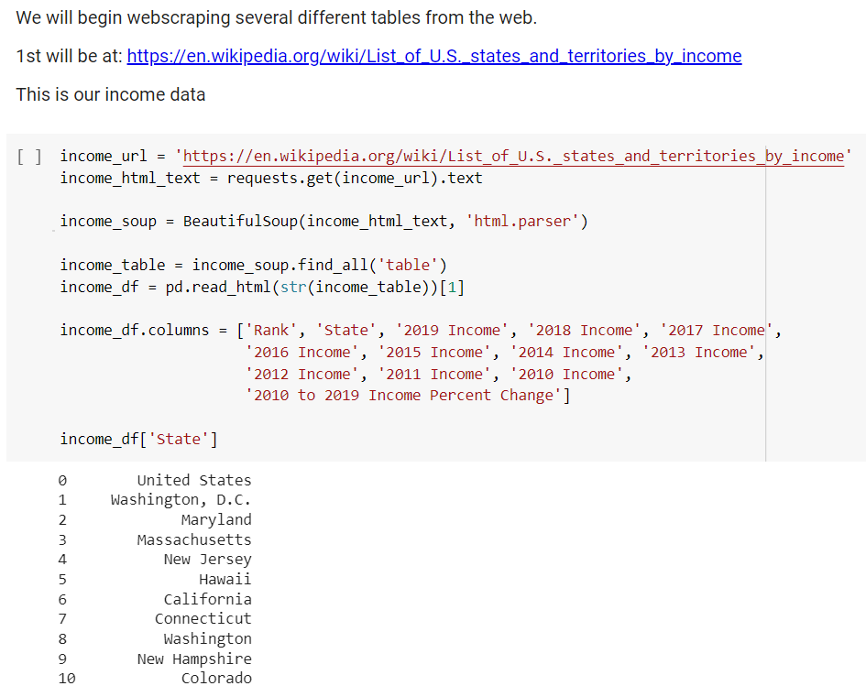
Working in python: Import data / Web scraping
Python was used to scrape web data for a variety of sources. This includes income data and personal debt data. A CSV file is also imported about state population and debt data, cost of living, happiness data.

Slide 3
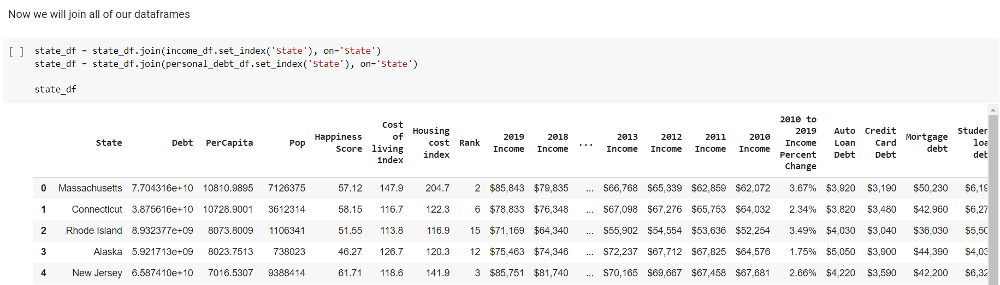
JOIN our data

Slide 4
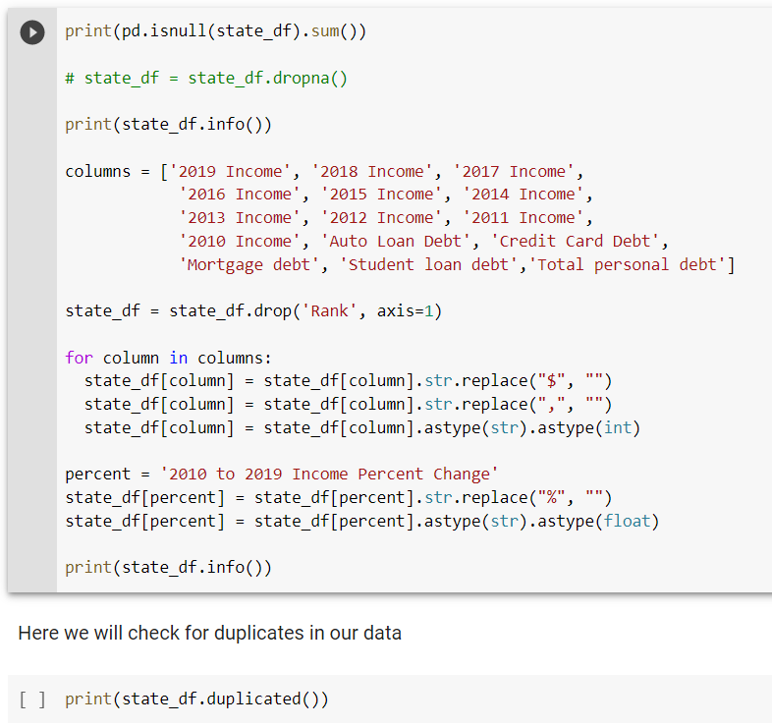
Data cleaning
Data cleaning consisted of 4 steps:
1. Check for null values and drop if necessary
2. Drop unnecessary columns
3. Strip columns of dollar signs, columns and convert to correct data types
4. Check for duplicates

Slide 5
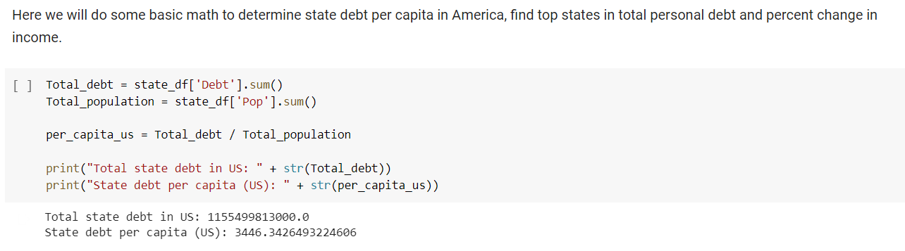
Python data calculations (1)

Slide 6
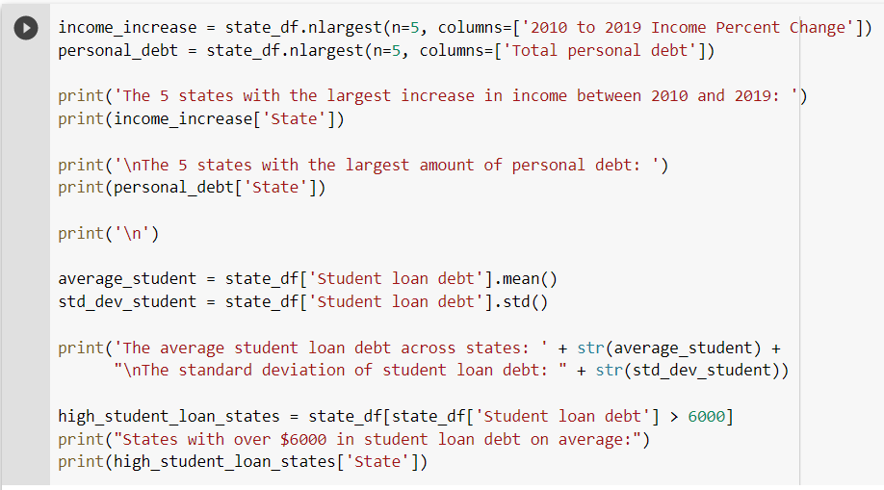
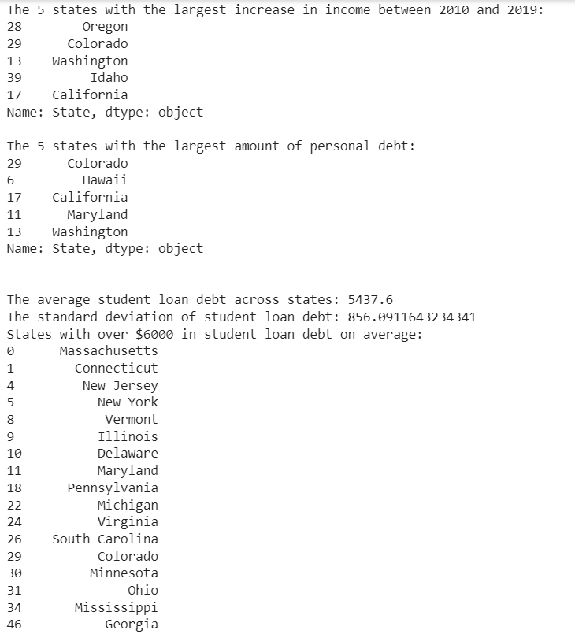
Python data calculations (2)

Slide 7
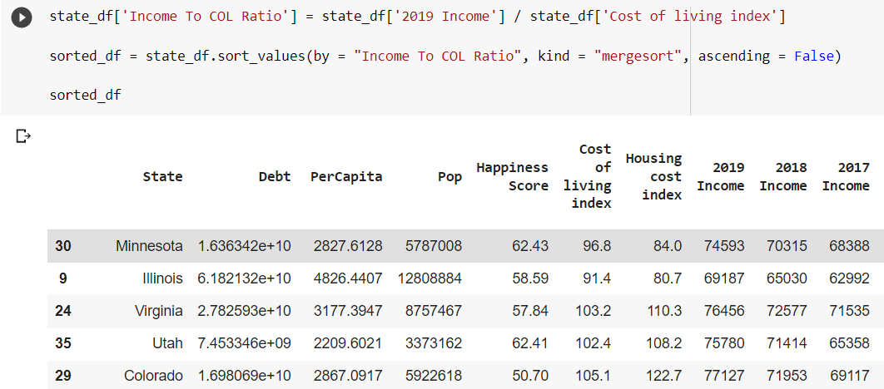
Python data calculations (3)

Slide 8
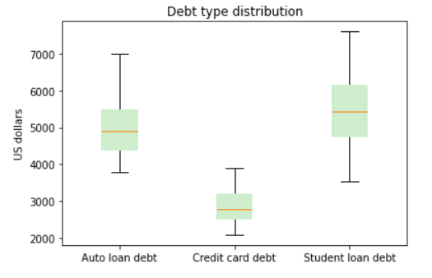
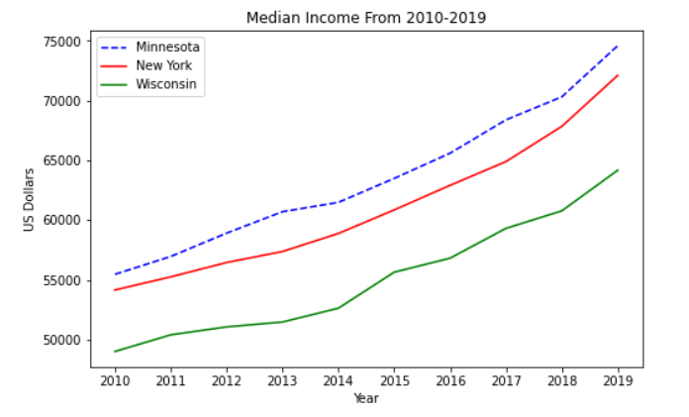
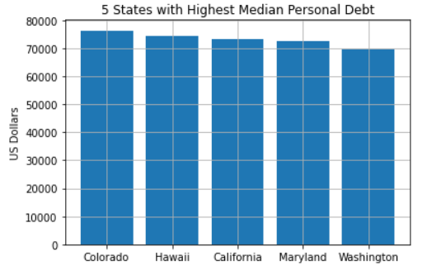
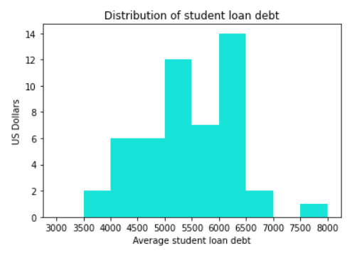
Python Visualizations

Slide 9
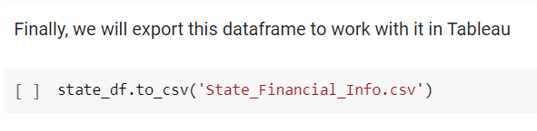
Exported Our dataframe to CSV

Slide 10
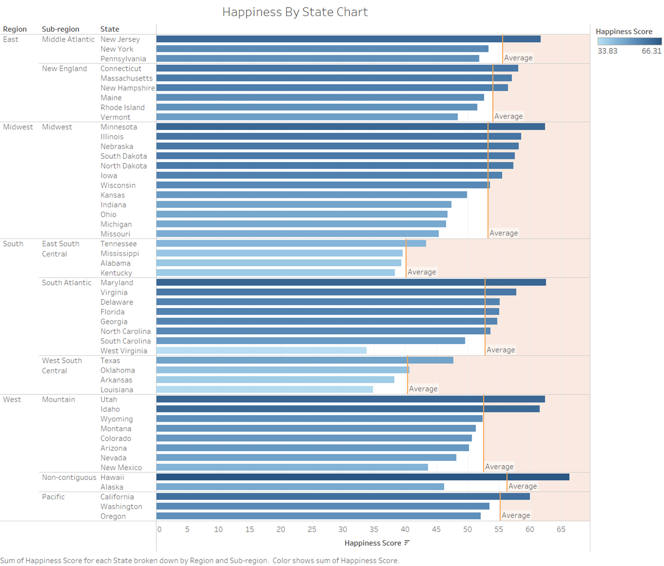
Tableau Visualizations

Slide 11
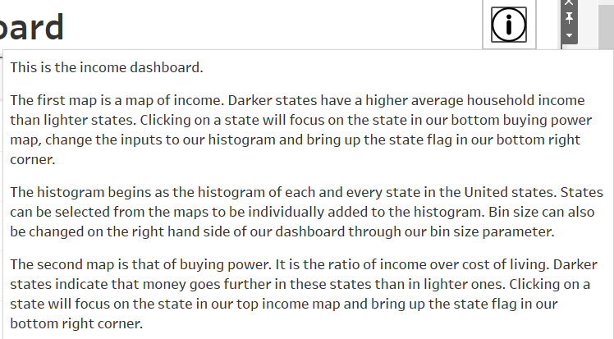

Slide 12
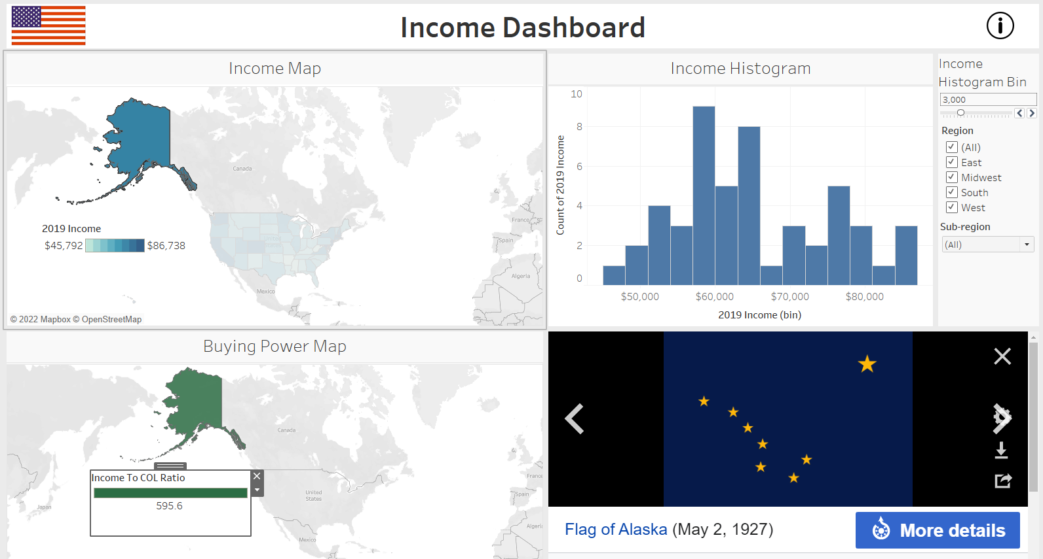

Slide 13
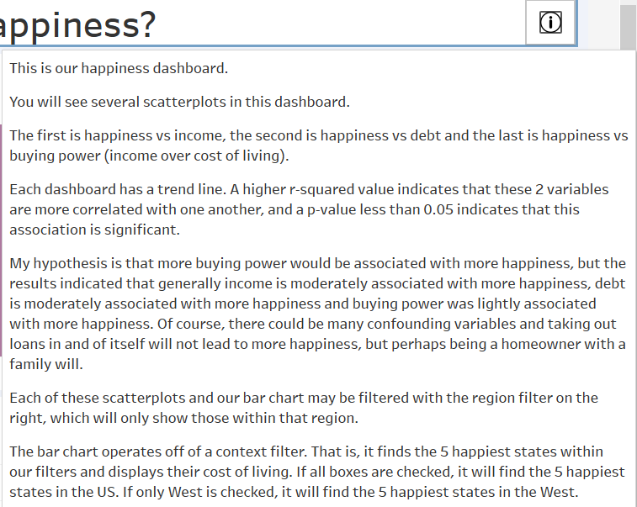

Slide 14
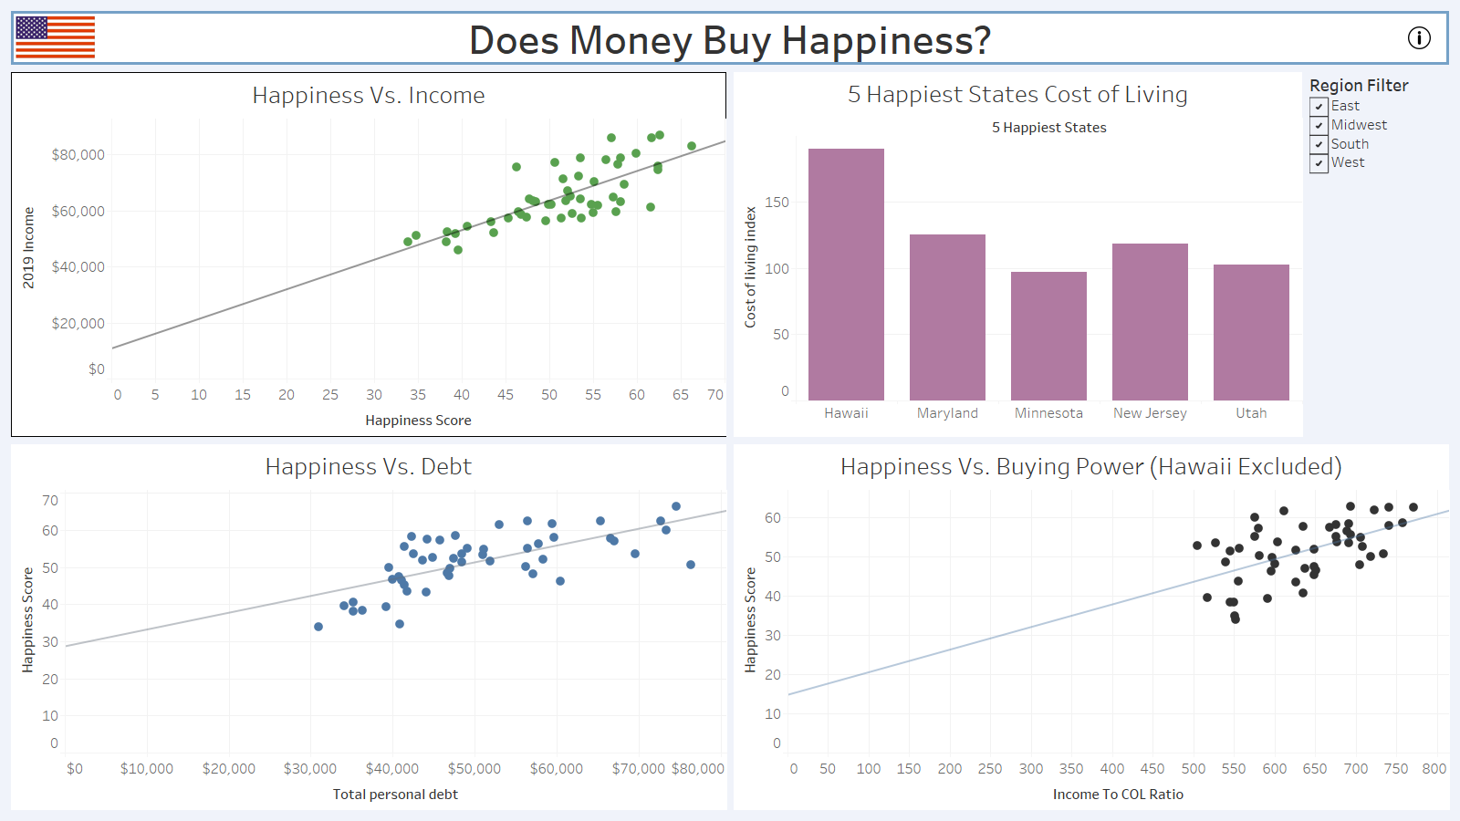

Slide 15
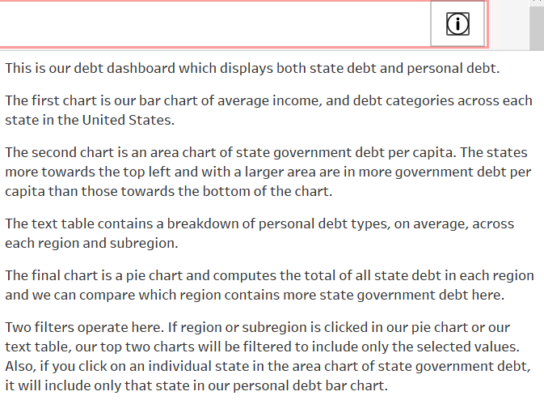

Slide 16
